Slide 1
Introduction to
Data Science and Machine Learning
Bhanu Chander V

Slide 2
Technology Recap
Machine Learning:
(Intelligence with Data)
Data Driven Models
Artificial Intelligence (AI)
Supervised Learning
Un-Supervised Learning
Reinforcement Learning (RL)
Semi-Supervised Learning
Artificial Intelligence:
Machine Learning
(ML)
Maths & Stats
(Intelligence with and without Data)
All ML
Optimization and Path Planning Algorithms (ACO, A*, Swarm)
Genetic Algorithm, Simulated Annealing etc.

Slide 3
Data Science Process
Who: Executives, Project Managers, Tech Leads etc.
(Understanding product portfolio and creating/ Introducing Data-driven digital solutions
1
Business Understanding (Problem Definition)
Data Acquisition
Data Processing (Structuring, cleaning)
Data Analysis
(Model building, trends, Intelligent decisions)
Report out, Deployment
Who: Data Scientist or
Cloud Engineer
Reporting
Cloud or Edge Deployment
CI/CD, MLops
2
5
Who: Experts, operators etc.
From Sensors
Historical database
Manual entry
ETL (Extract Transform Load)
4
3
Who: Data Scientist
Building ML models
Training
Validating
Testing on new data
Who: Data Scientist
(Unstructured to Strcutured)
Formatting
Visualization
EDA, Cleaning
Data Preparation

Slide 4
Step 1 : Data
Problem
Get Data
Process Data
Report & Deploy
Analyze Data
Data (Raw data) from sources are messy (Unstructured)
Columns (Features, sensor entries)
 | sensor 1 | sensor 2 | sensor 3 | sensor 2
1 | 0.01 | 122 | yes
2 | -0.24 | 164 | no
3 |  | 152 | no
4 | 0.02 | 12-Mar-92 | yes
5 | 0.11 |  | yes | 177
6 | 0 |  | 12:16PM | 189
7 | 120 | inf | yes
1. Missed Entries (sensor errors)
DataFrame
(Data Table)
2. Incorrect Entries (wrong datatype)
3. Outliers/Anomalies
4. Repetitions (rows/columns) etc.
Rows (Indices, samples) captured on fixed time stamp
Data categories:
Numerical Data: Ex. Numbers
Categorical Data: Ex. Yes/No, colors, types
Data Types: (dtypes)
Integers, Float, bool, datetime, object (dictionary format)

Slide 5
Step 2 : Data Visualization
Problem
Process Data
Get Data
Report & Deploy
Analyze Data
Visualization as first step, why?
What can you deduce from this plot?
Some data entries are missing between 50th and 100th hours
Entry at 37th hour seems infinite or erroneous input
After 137th hour the system seems idle or off (this data may not be useful to analyze or use for ML training)
Initial Visualization can help in giving a quick glimpse of data and in understanding their patterns. It reduces an engineer’s effort, time and resource to be spent for analyzing the raw data and can help her/him focus on the right chunk of data

Slide 6
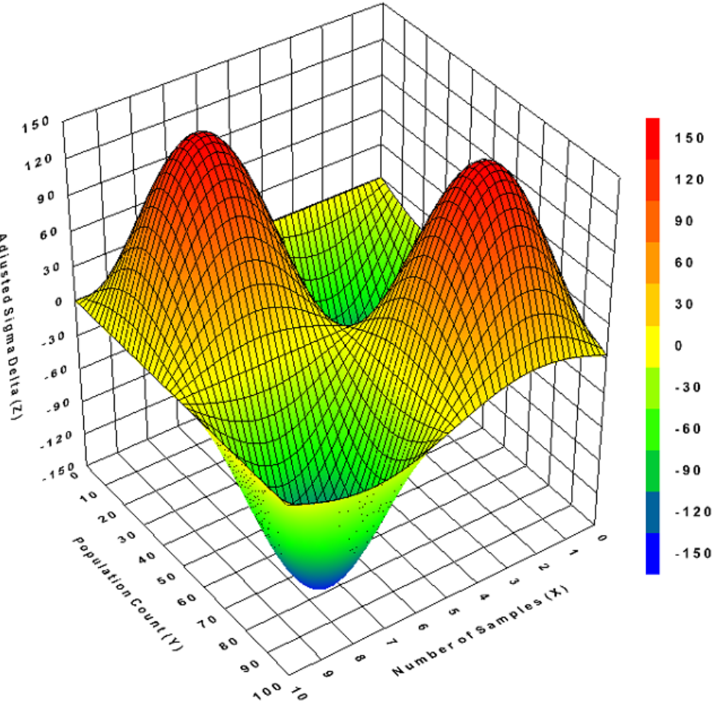
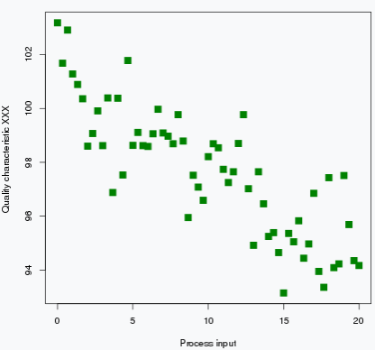
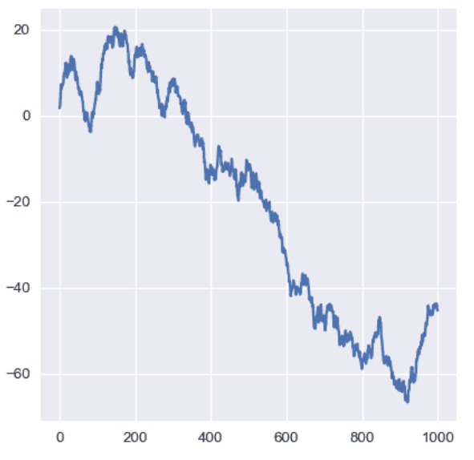
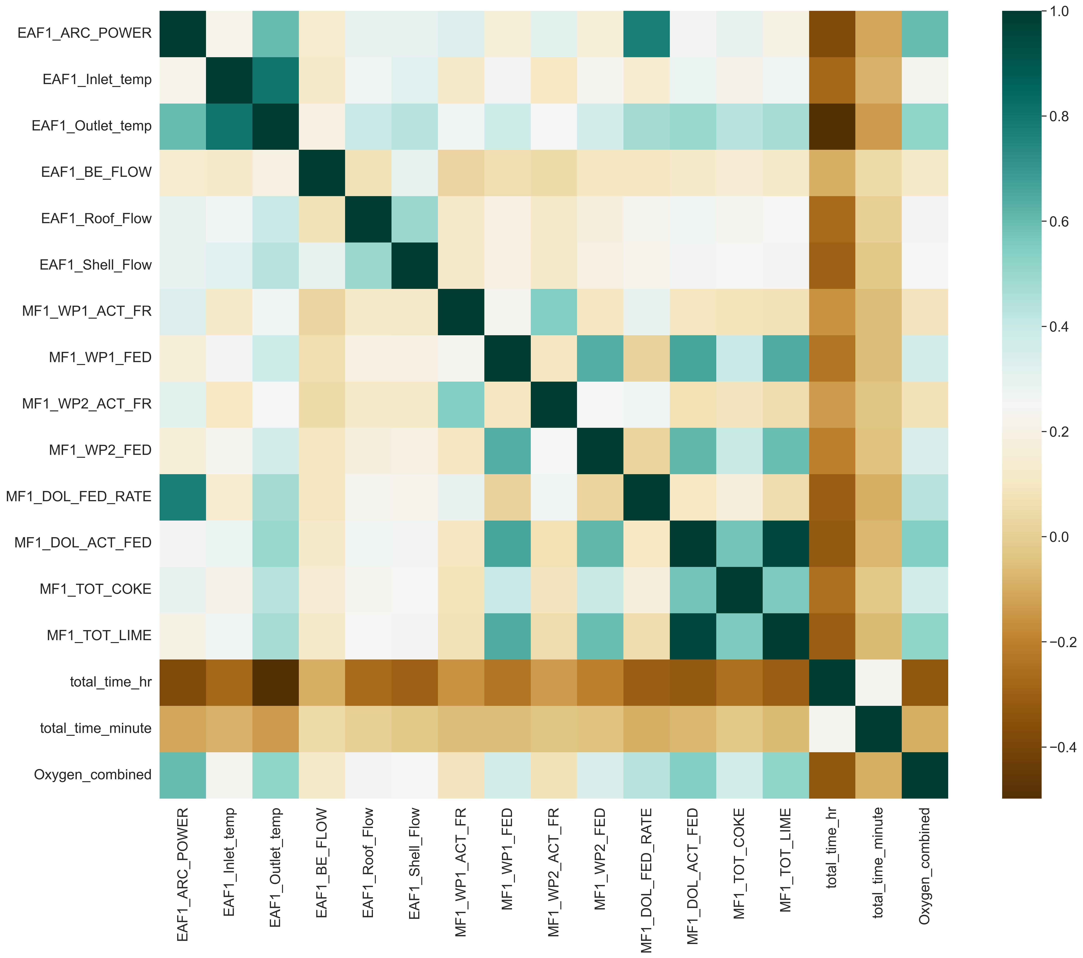
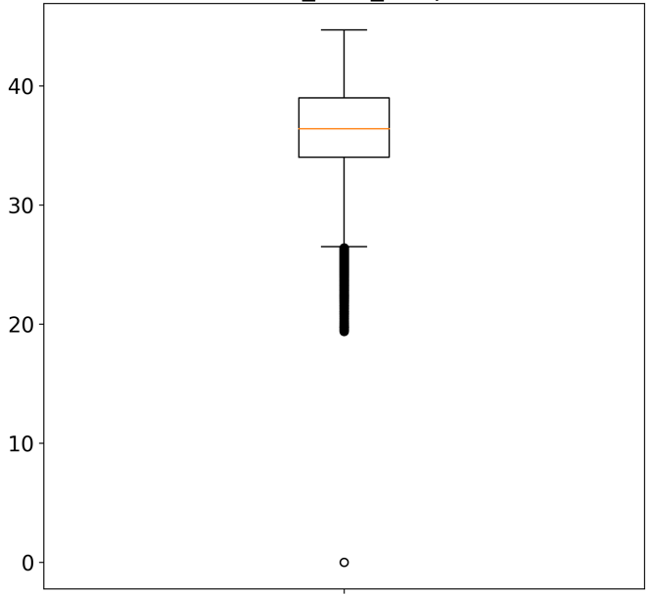
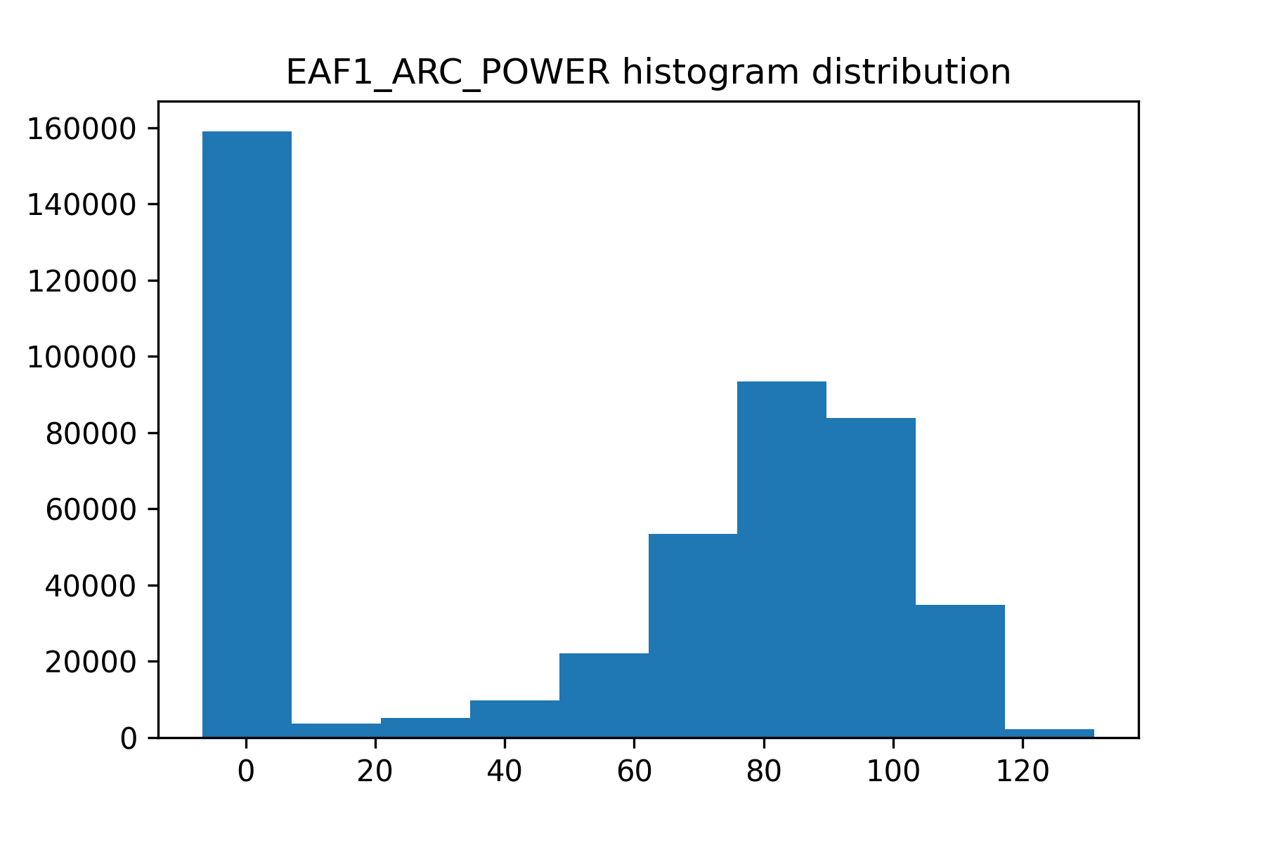
Data Visualization (contd…)
Problem
Process Data
Get Data
Report & Deploy
Analyze Data
Recommended Vis Tools
Surface Plot
Scatter Plot
Python Libraries
Line Plot
Matplotlib
seaborn
Box Plot
Histogram
Heat Map

Slide 7
Step 2 : EDA & Data Cleaning
Problem
Process Data
Get Data
Report & Deploy
Analyze Data
EDA – Exploratory Data Analysis
(Basically, checking stats before cleaning data)
 | Pressure | Temp | Rotor Angle | Rotor RPM | Arm displacement
count | 467459.0 | 467459.0 | 467459.0 | 467459.0 | 467459.0
mean | 642.8 | 233727.9 | 54.5 | 1058.4 | 1550.6
std | 986.7 | 134943.1 | 42.2 | 1174.4 | 1479.4
min | 0.0 | 0.0 | -6.6 | 0.0 | 0.0
25% | 257.0 | 116864.5 | 0.0 | 539.0 | 347.0
50% | 342.0 | 233727.0 | 72.1 | 581.0 | 353.0
75% | 418.0 | 350591.5 | 90.3 | 624.0 | 3289.0
max | 9777.0 | 467456.0 | 131.0 | 9508.0 | 9432.0
Make a DataFrame using ‘Pandas’ library
Try:
df.info( )
df.count( )
df.columns
df.head( )
df.tail( )
Import pandas as pd
df = pd.DataFrame(Data)
df.describe( )

Slide 8
EDA & Data Cleaning (contd…)
Problem
Process Data
Get Data
Report & Deploy
Analyze Data
Cleaning Data
 | Temp. | Dummy | Speed
1 | 24 |  | 1200
2 | 22 |  | 1270
3 |  |  | 18-mar
4 | 23 |  | -200
5 |  |  | 1300
6 | 22 |  | 1190
7 | 24
8 | 23 |  | 1240
Data after little cleaning
 | Temp. | Speed
1 | 24 | 1200
2 | 22 | 1270
6 | 22 | 1190
8 | 23 | 1240
Data before cleaning
Try:
df.isnull( ).sum( )
df.dropna(inplace = True)
df = df.drop([‘Dummy'], axis=1)
df.drop( df.index[ df[‘Speed’] < 0], inplace=True)
df[‘Temp.’].fillna( value = df. [‘Temp.’].mean( ), inplace=True)
df.replace(to_replace = np.nan, value = mean)
df[‘Speed’].replace(to_replace = df[‘Speed’]<0, value = 0)
df[‘Speed’].iloc[df[‘Speed’]<0] = 0
Remember to use plots

Slide 9
Step 2 : EDA & Data Cleaning
Problem
Process Data
Get Data
Report & Deploy
Analyze Data
Hands-on Demo in Python

Slide 10
Step 3 : Analyze Data
Problem
Analyze Data
Get Data
Report & Deploy
Process Data
Machine Learning
Algorithms
Algorithms that can do both
Regression and classification
Type
Linear, Polynomial Regression
Neural Networks (ANN, CNN, Deep Learning)
KNN – K Nearest Neighbours
Forest based - Decision Trees, Random Forest, XGBoost etc.
Support Vector Machines (SVM)
Regression
Supervised Learning
Target: Continuous values
(Trained with Target/Labels)
Classification
Logistic Regression,
Naïve Bayes
Target: Categories
(Yes/No, colors, types,
Categories)
Ex. Task: Given Temp and Angle,
predict the rpm of the motor
Type
Algorithms
K-means clustering.
KNN
Hierarchal clustering
Anomaly detection
Principle Component Analysis (PCA)
Input (Features)
Target (labels)
Clustering
Un-Supervised Learning
Temp | angle | RPM
27 | -0.005 | 1363
26 | 0.015 | 1303
26 | 0.001 | 1334
23 | -0.032 | 1340
21 | -0.003 | 1200
27 | 0.000 | 1220
(Trained without Target/Labels)
Dimensionality Reduction

Slide 11
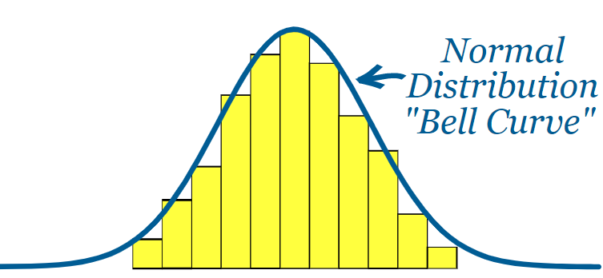
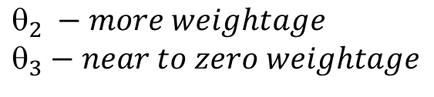
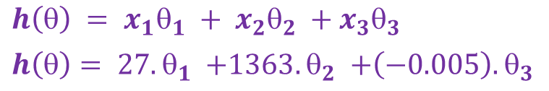
Step 2 : Preparing Data
Problem
Process Data
Get Data
Report & Deploy
Analyze Data
Scaling - Why needed?
$$h\left(θ\right) = {x_{1}θ}_{1}{ +{ x}_{2}θ}_{2}{ +{ x}_{3}θ}_{3}$$
$h\left(θ\right)= {27.θ}_{1}{ +1363. θ}_{2}{ +\left(−0.005\right).θ}_{3}$
$$_{2} −more weightage$$
$$_{3}−near to zero weightage$$
Raw data
Scaled Data (Normalized)
 | feature 1 | feature 2 | feature 3
1 | 27 | 1363 | -0.005
2 | 26 | 1303 | 0.015
3 | 26 | 1334 | 0.001
4 | 23 | 1340 | -0.032
5 | 21 | 1200 | -0.003
6 | 27 | 1220 | 0.000
7 | 26 | 1314 | 0.027
8 | 23 | 1322 | -0.004
9 | 24 | 1212 | 0.070
10 | 27 | 1234 | -0.001
11 | 24 | 1266 | -0.016
12 | 28 | 1270 | -0.032
13 | 22 | 1328 | 0.028
14 | 24 | 1227 | 0.009
feature 1 | feature 2 | feature 3
0.86 | 1.00 | 0.26
0.71 | 0.63 | 0.46
0.71 | 0.82 | 0.32
0.29 | 0.86 | 0.00
0.00 | 0.00 | 0.28
0.86 | 0.12 | 0.31
0.71 | 0.70 | 0.58
0.29 | 0.75 | 0.27
0.43 | 0.07 | 1.00
0.86 | 0.21 | 0.30
0.43 | 0.40 | 0.16
1.00 | 0.43 | 0.00
0.14 | 0.79 | 0.59
0.43 | 0.17 | 0.40
Scaling ensures equal weightage to all the features. Hence the problem of some features getting ignored can be eliminated

Slide 12
Train-Validation-Test
Problem
Analyze Data
Get Data
Report & Deploy
Process Data
Data Split - Why needed?
Scaled Data (Normalized)
feature 1 | feature 2 | feature 3
0.86 | 1.00 | 0.26
0.71 | 0.63 | 0.46
0.71 | 0.82 | 0.32
0.29 | 0.86 | 0.00
0.00 | 0.00 | 0.28
0.86 | 0.12 | 0.31
0.71 | 0.70 | 0.58
0.29 | 0.75 | 0.27
0.43 | 0.07 | 1.00
0.86 | 0.21 | 0.30
0.43 | 0.40 | 0.16
1.00 | 0.43 | 0.00
0.14 | 0.79 | 0.59
0.43 | 0.17 | 0.40
(70%)
Training Set
Validation Set
(20% of 70%)
(30%)
Test Set

Slide 13
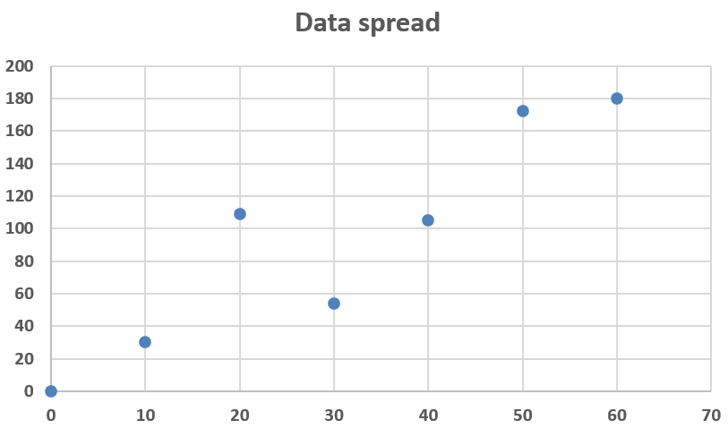
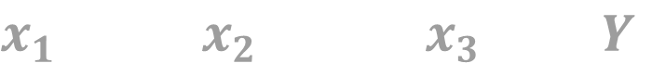
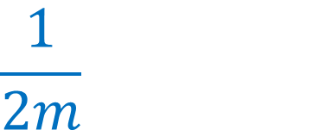
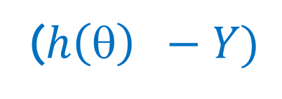
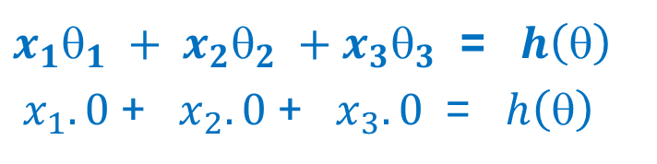
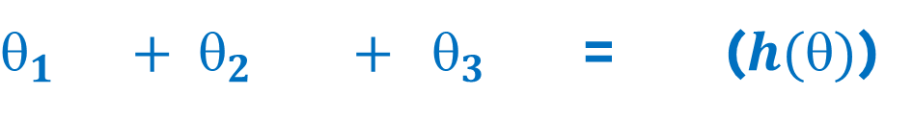
Regression ML
Problem
Analyze Data
Get Data
Report & Deploy
Process Data
ML Hypothesis (Cost Function)
Ex. Task: Given Temp, Angle and pressure, predict the rpm of the motor
$$x_{1}{ x}_{2}{ x}_{3} Y$$
$_{1}{ + }_{2}{ + }_{3}$ = ($h()$)
${x_{1}}_{1}{ +{ x}_{2}}_{2}{ +{ x}_{3}}_{3}$ = $h\left(θ\right)$
${ x}_{1}.0$+ ${ x}_{2}.0$+ ${ x}_{3}.0$ = $h\left(θ\right)$
Dependent Variable
Temp | angle | Pressure | RPM
27 | -0.005 | 251 | 1363
26 | 0.015 | 242 | 1303
Why a curve?
........To predict for future/unseen values
Btw, ML Focus is not on passing through max no. of data points but on minimizing the sum of errors!
We have to minimize the error so that we get a best fit line
$$\frac{1}{2m}$$
2
Σ
J (error) =
($h\left(θ\right) −Y)$
This relation we name as: Objective Function
Cost Function

Slide 14
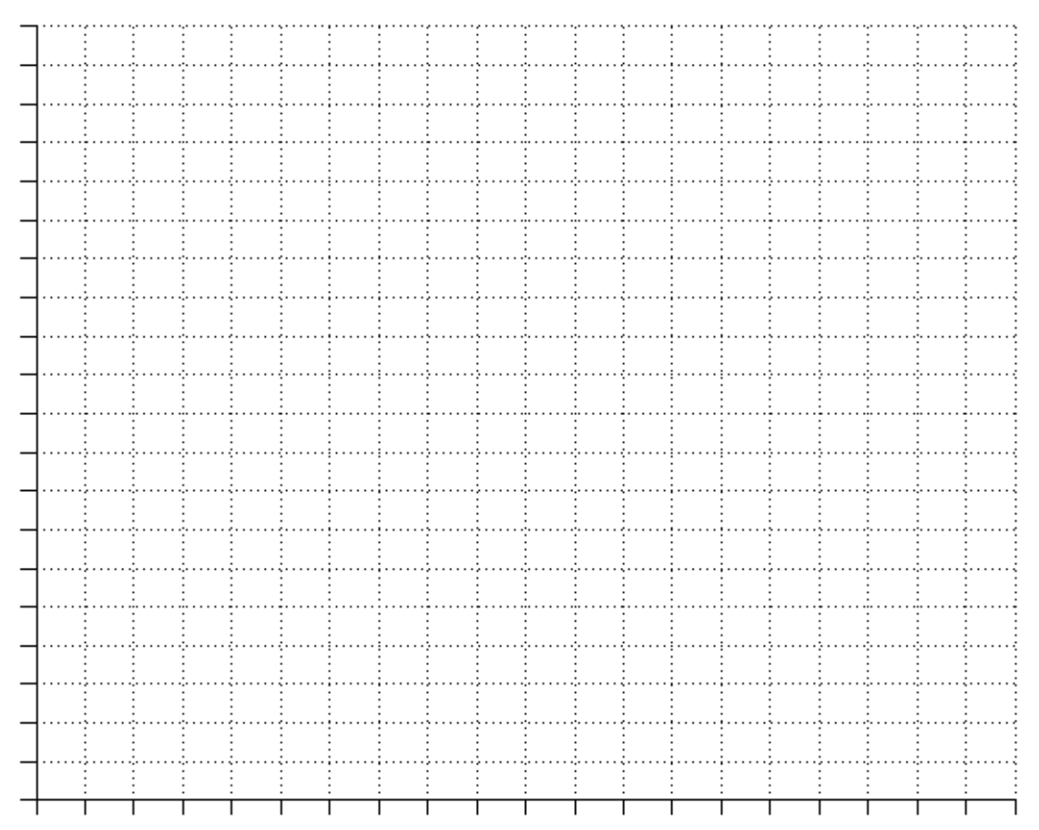
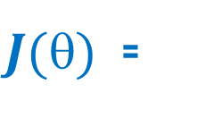
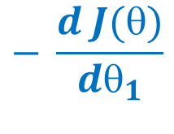
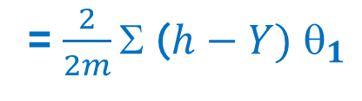
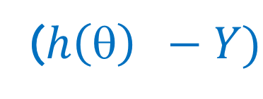
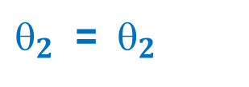
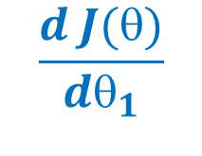
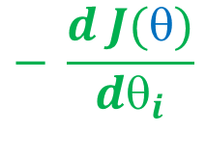
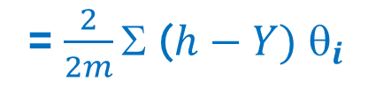
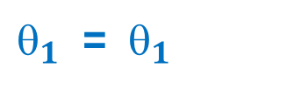
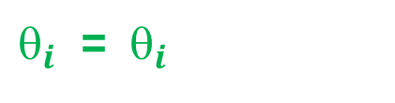
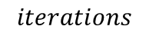
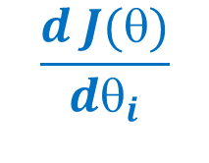

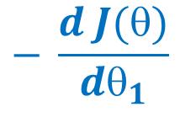
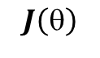
Regression ML
Problem
Analyze Data
Get Data
Report & Deploy
Process Data
ML Hypothesis (Cost Function)
Ex. Task: Given Temp, Angle and pressure, predict the rpm of the motor
$$\frac{1}{2m}$$
2
Iteration 1: Initiate θ’s, find J(θ),
update θ’s using derivatives
Iteration 2: Use updated θ’s from step 1, find J(θ),
update θ’s using derivatives
Iteration 3: Use updated θ’s from step 2, find J(θ),
update θ’s using derivatives
…….and so on
Σ
($h\left(θ\right) −Y)$
$J()$ =
$$\frac{d J(θ)}{dθ_{1}}$$
= $\frac{2}{2m}\text{Σ} \text{(}h−Y)$ $_{1}$
$$\frac{d J(θ)}{dθ_{i}}$$
= $\frac{2}{2m}\text{Σ} \text{(}h−Y)$ $_{i}$
$$J\left(θ\right)$$
$$− \frac{d J(θ)}{dθ_{1}}$$
$$− \frac{d J(θ)}{dθ_{1}}$$
$$− \frac{d J(θ)}{dθ_{i}}$$
$_{1}$ = ${ }_{1}$
${ }_{2}$ = ${ }_{2}$
${ }_{i}$ = ${ }_{i}$
$$iterations$$

Slide 15
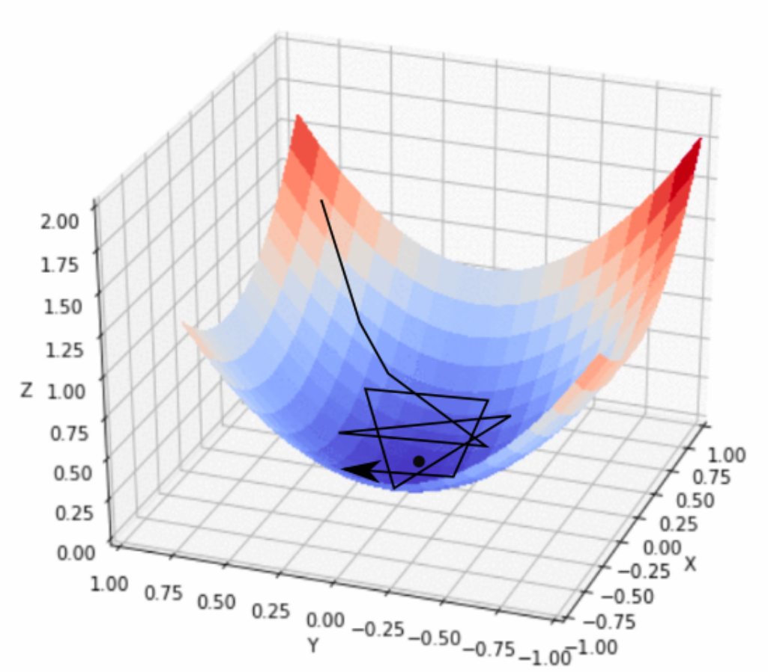
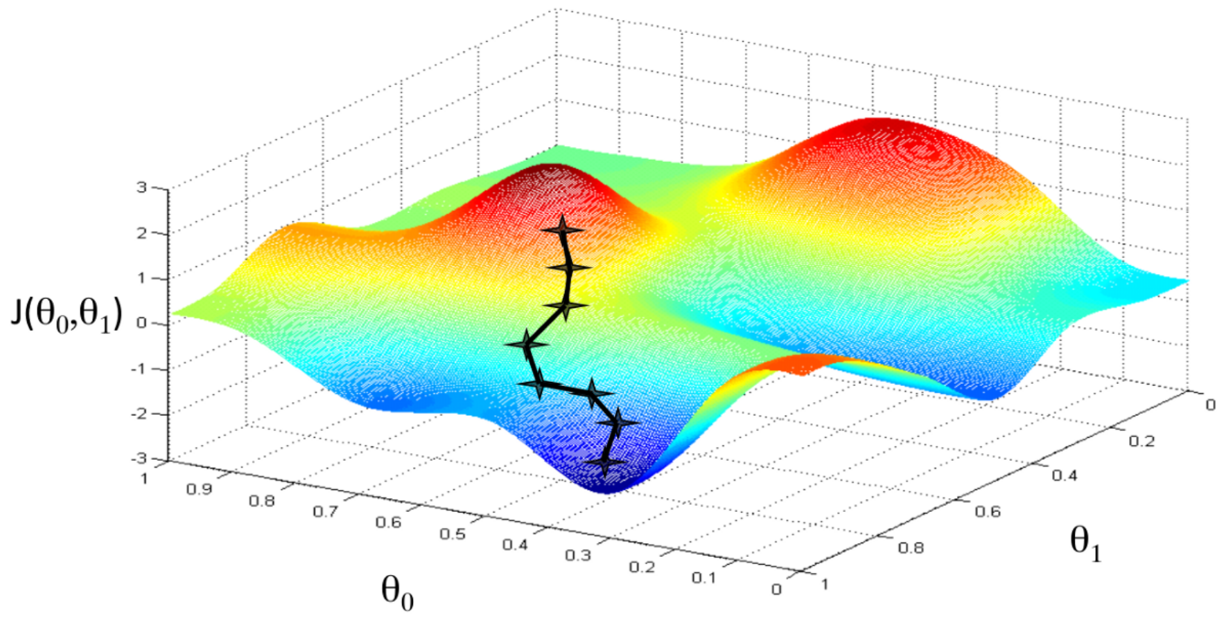
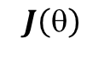
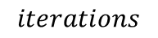
(contd…) Regression ML
Problem
Analyze Data
Get Data
Report & Deploy
Process Data
Stochastic Gradient Descent
$$J\left(θ\right)$$
Local Optima
$$iterations$$

Slide 16

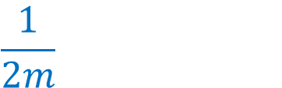
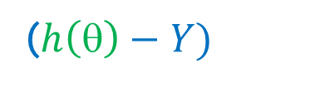
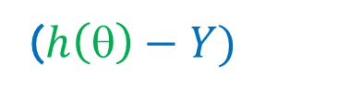
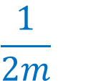
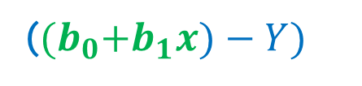
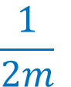
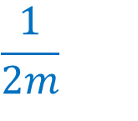
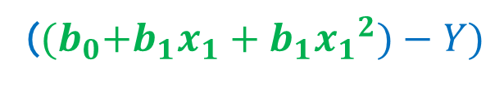
Regression Types
$$\frac{1}{2m}$$
$$\frac{1}{2m}$$
Σ
2
Σ
2
($h\left(θ\right)−Y)$
J =
($h\left(θ\right)−Y)$
J =
$$\frac{1}{2m}$$
Σ
2
$$\frac{1}{2m}$$
Σ
2
J =
(${(b}_{0}+b_{1}x)−Y)$
J =
(${(b}_{0}+b_{1}x_{1}+b_{1}{x_{1}}^{2})−Y)$

Slide 17
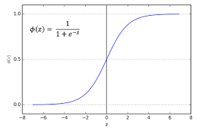

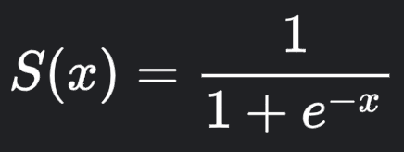
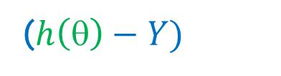
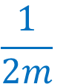
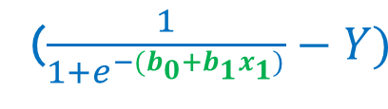
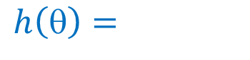
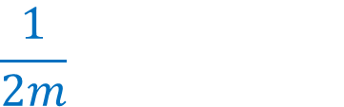
Classification ML
Logistic Regression
Sigmoid Function
$$h\left(θ\right)=$$
Multinomial Classification
Binomial Classification
Inputs
Targets
x1 | x2 | x3 | Blue
27 | 1363 | -0.005 | 1
26 | 1303 | 0.015 | 0
26 | 1334 | 0.001 | 0
23 | 1340 | -0.032 | 1
21 | 1200 | -0.003 | 1
27 | 1220 | 0.000 | 1
Green | Yellow
0 | 0
1 | 0
0 | 1
0 | 0
1 | 0
0 | 1
$$\frac{1}{2m}$$
Σ
2
J =
($h\left(θ\right)−Y)$
$$\frac{1}{2m}$$
Σ
J =
($\frac{1}{1+e^{−{(b}_{0}+b_{1}x_{1})}}−Y)$
2

Slide 18
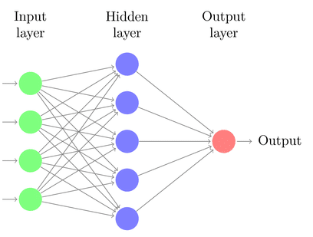




x1 | x2 | x3 | x4 | Blue
27 | 1363 | -0.005 | 169 | 1
26 | 1303 | 0.015 | 124 | 0
26 | 1334 | 0.001 | 113 | 0
Neural Network (Deep Learning)
$$a1=\frac{1}{1+e^{−( b_{0}^{1}+{b_{1}^{1}x}_{1}+b_{2}^{1}x_{2}+b_{3}^{1}x_{3}+b_{4}^{1}x_{4})}}$$
$$a2=\frac{1}{1+e^{−(b_{0}^{2}+{b_{1}^{2}x}_{1}+b_{2}^{2}x_{2}+b_{3}^{2}x_{3}+b_{4}^{2}x_{4})}}$$
a1
x1
$$a3=\frac{1}{1+e^{−(b_{0}^{3}+{b_{1}^{3}x}_{1}+b_{2}^{3}x_{2}+b_{3}^{3}x_{3}+b_{4}^{3}x_{4})}}$$
a2
Reg – Numeric (ex: 13.27)
Or Classification (ex: 13.27)
x2
.
.
.
.
.
a3
x3
a4
x4
a5

Slide 19


Classification Vs Clustering
Classification
Clustering
Supervised Learning with Target/Labels
Labels – Yes/No, color type, disease type etc.
Un-Supervised Learning with no Labels
Ex. – spam filter, Fraud detection,

Slide 20
ML Fields
Using Numerical Data – Sup, un-sup, Semi Sup, RL with data
Ex. → Most Industrial Applications, driverless cars, health monitoring apps (iwatch, tracking devices), Forecasts (weather, Disease breakout like COVID)
Image based – Computer Vision, Image Processing, video processing
Ex. → Camera App, Face recognition, Traffic monitoring, AI Art, Robot navigation, driverless cars
Text and Speech Based – NLP (Natural Language Processing)
Ex. → Google Search, Translate, ChatGPT, Google bard, Alexa, Siri
Other fields where ML is extensively used –
Medical → Ex. Tumor diagnosis, Cancer prediction, heartbeat monitoring etc.
Finance → Ex. Stock prediction, fraud credit/transaction detection,
Industry → Ex. Sales prediction, Inventory monitoring, spares, purchase strategies

Slide 21






Model Evaluation – Metrics for Regression
Metric | Relation | Pros | Cons
Mean Absolute Error (MAE) |  | Robust to outliers Same unit as output variable (not too much weight on outliers) | Not differentiable Doesn’t tell Direction information
Mean Squared Error (MSE) |  | Used as Loss Function RMSE gives a relatively high weight to large errors | Not robust to outliers (Higher MSE Values)
Root Mean Squared Error (MSE) |  | Same unit as output variable Lower values of MSE indicate better fit. RMSE gives a relatively high weight to large errors | Not robust to outliers (Higher MSE Values)
Root Mean Squared Logaritmic Error (RMSLE)
R2 Score |  | A higher R-squared value generally indicates a better fit, although other factors, such as the complexity of the model and the risk of overfitting, should also be considered.

Slide 22
Model Evaluation – Metrics for Classification
For Classification:

Slide 23
ML Model Selection and Model Tuning

Slide 24
Forest Algorithms – Decision Trees, Random Forests

Slide 25
K-Nearest Neighbours

Slide 26
K-Means Clustering

Slide 27
Why ML?

